Slide 1


Where is clinical research done?
CHPS on display
RR Townsend
November 13 2019
0915h – 0945h

Slide 2
What is Clinical Research?
Clinical Research is Research with human subjects that is:
Patient-oriented research. Research conducted with human subjects (or on material of human origin such as tissues, specimens, and cognitive phenomena) for which an investigator (or colleague) directly interacts with human subjects. Excluded from this definition are in vitro studies that utilize human tissues that cannot be linked to a living individual. It includes:
  mechanisms of human disease
  therapeutic interventions
  clinical trials
  development of new technologies
Epidemiological and behavioral studies.
Outcomes research and health services research.

Slide 3
What is translational research?
3
“Translational research means different things to different people, but it seems important to almost everyone”
  Stephen Woolf, JAMA, 2008
Commonly used terms: clinical research, patient-oriented research, translational research
NIH roadmap: Zerhouni, Science 2003
“Bench to bedside”

Slide 4
What do I need to do human research?
Training
Mentor
Vocabulary
Structure/Space
Ideas
Subjects
Datasets
Regulatory
Resource Locator
Protected Time
Statistical Support
Funding
Knowledgelink
Collaborators/Community
Coaching/Writing
Passion
Persistence

Slide 5

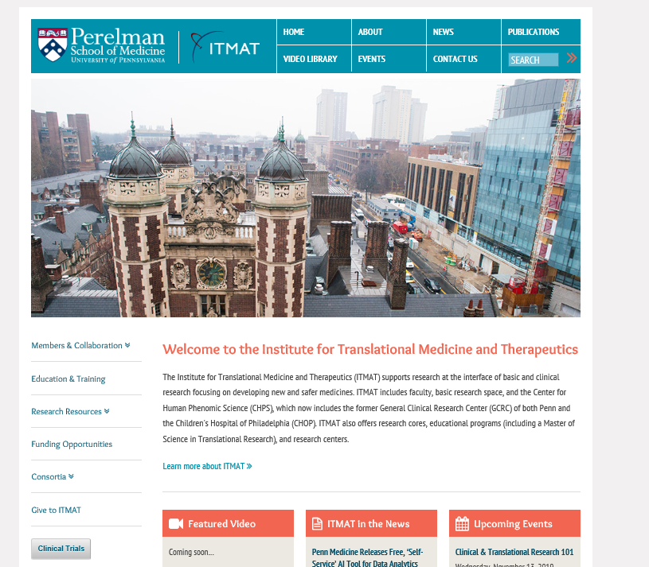
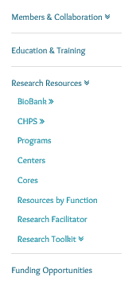
http://www.itmat.upenn.edu/

Slide 6
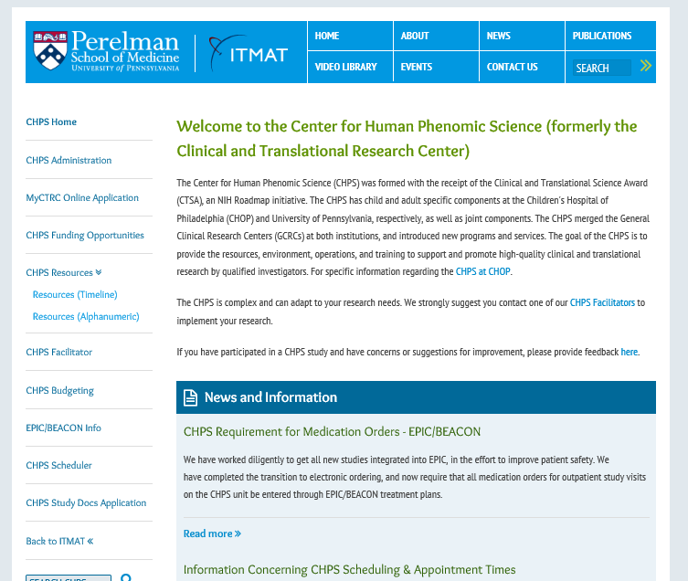
https://www.med.upenn.edu/chps/

Slide 7
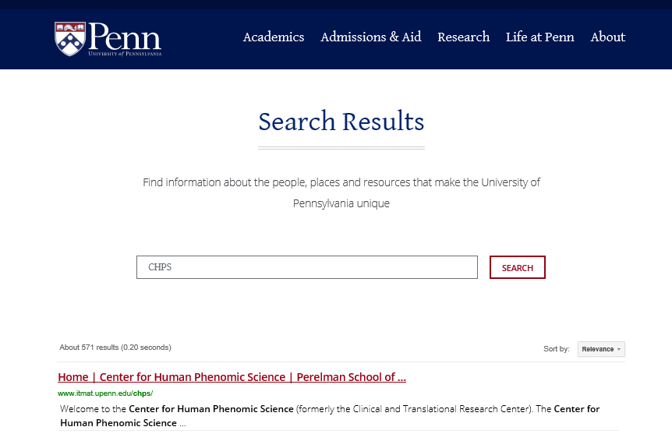
https://www.upenn.edu/

Slide 8
Three sites for CHPS
4 PCAM South – outpatient
1 Dulles – inpatient and metabolic room
Mutch Building at Presbyterian – 1st Floor

Slide 9
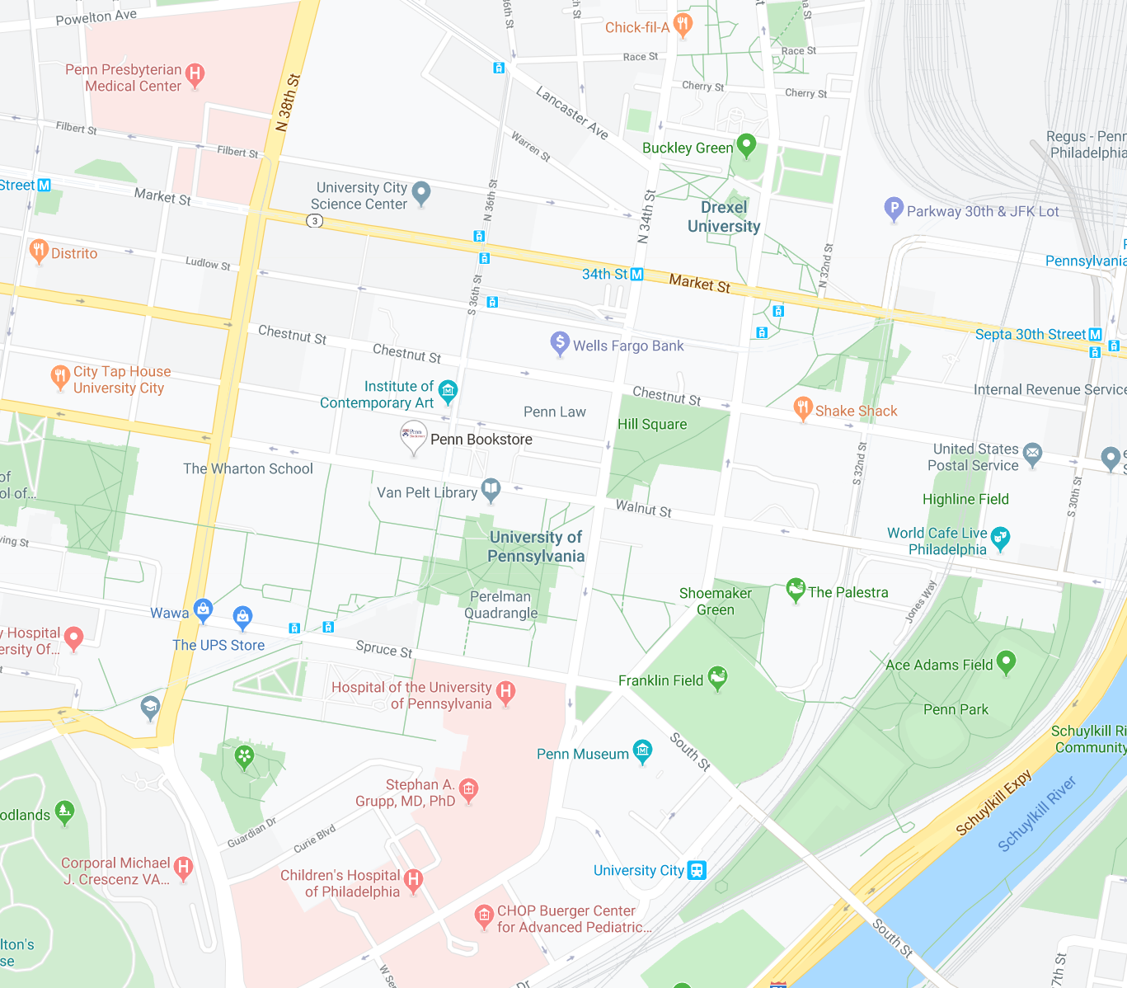

Slide 10
What does the CHPS offer as services/cores
Nursing services (blood draw, medication administration, vitals)
Biospecimen processing areas
Variety of rooms – beds, chairs, tables
Biostatistical Support
Intramural funding program (JIPGP)
Bionutrition
Exercise testing (supinebicycle, treadmill)
Cardiovascular measures (echo, tonometry, heart rate variability)
http://www.itmat.upenn.edu/chps/resources-alpha.html

Slide 11
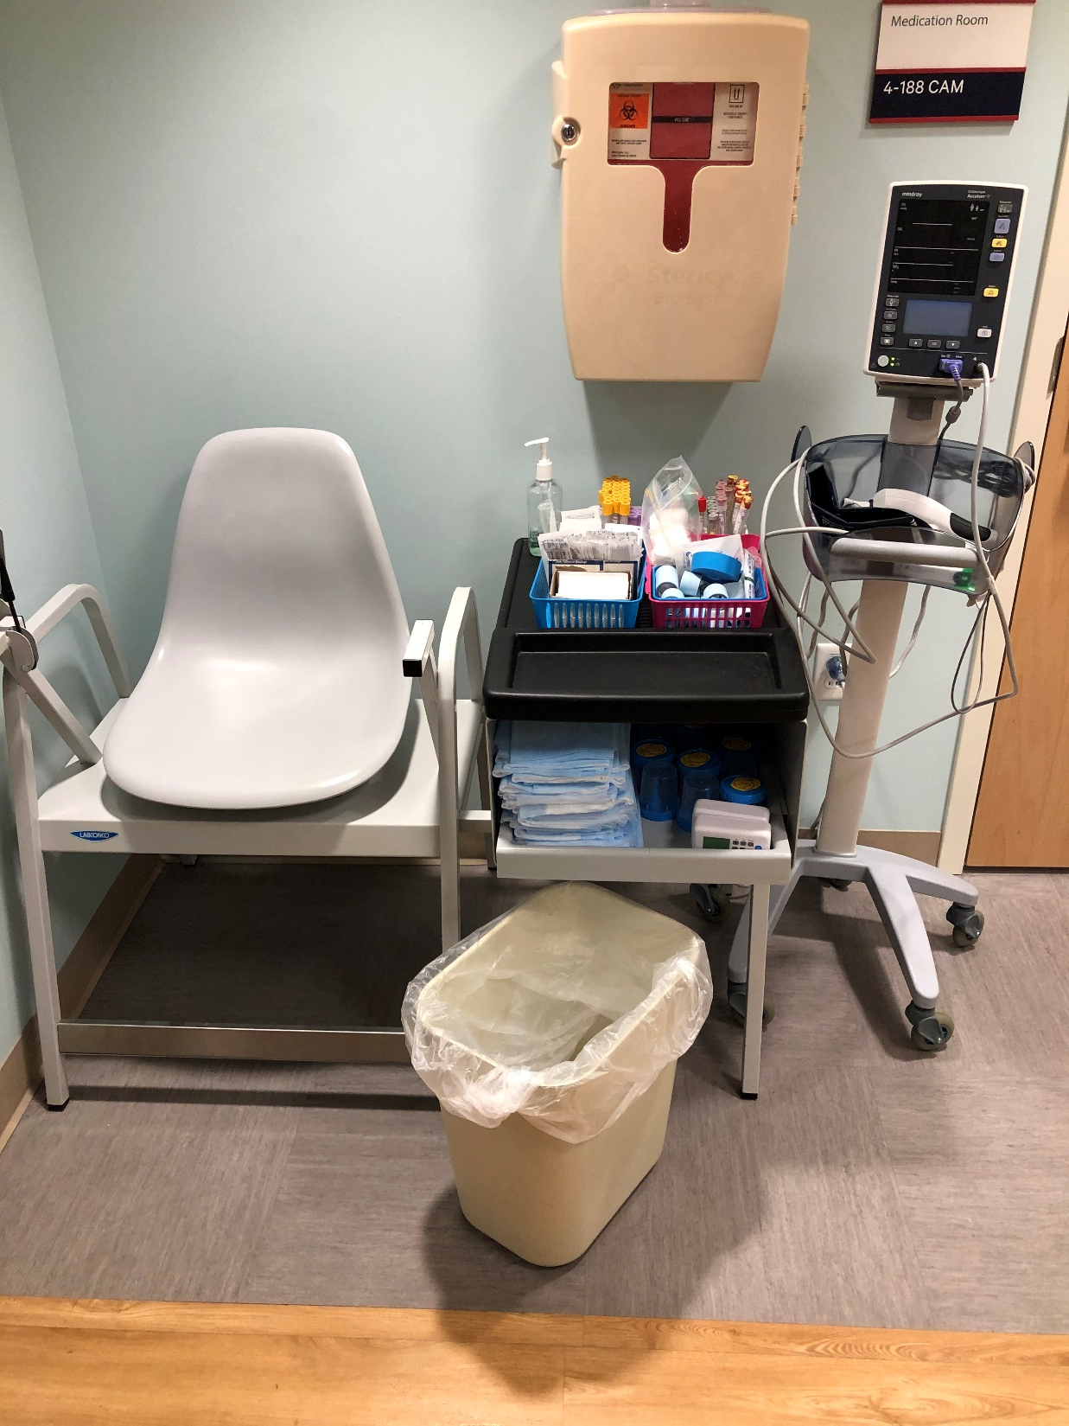
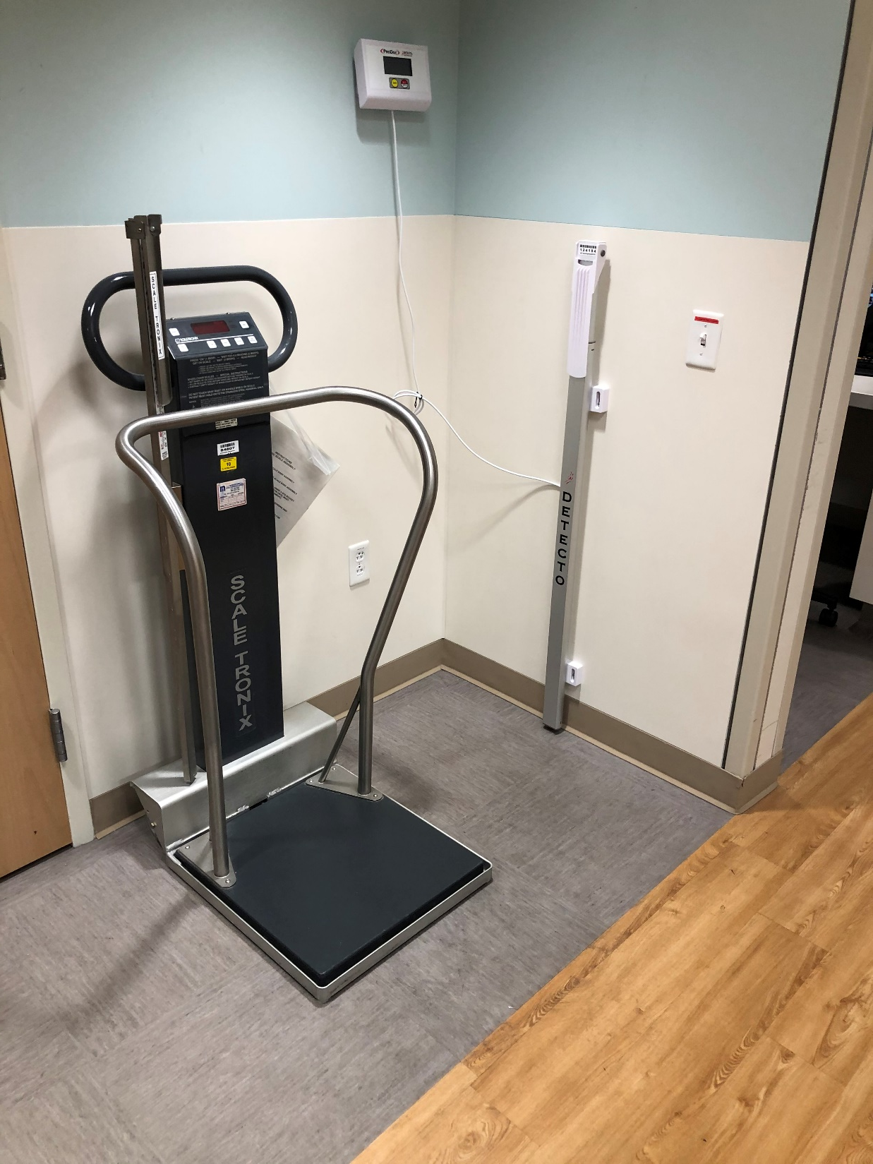

Slide 12
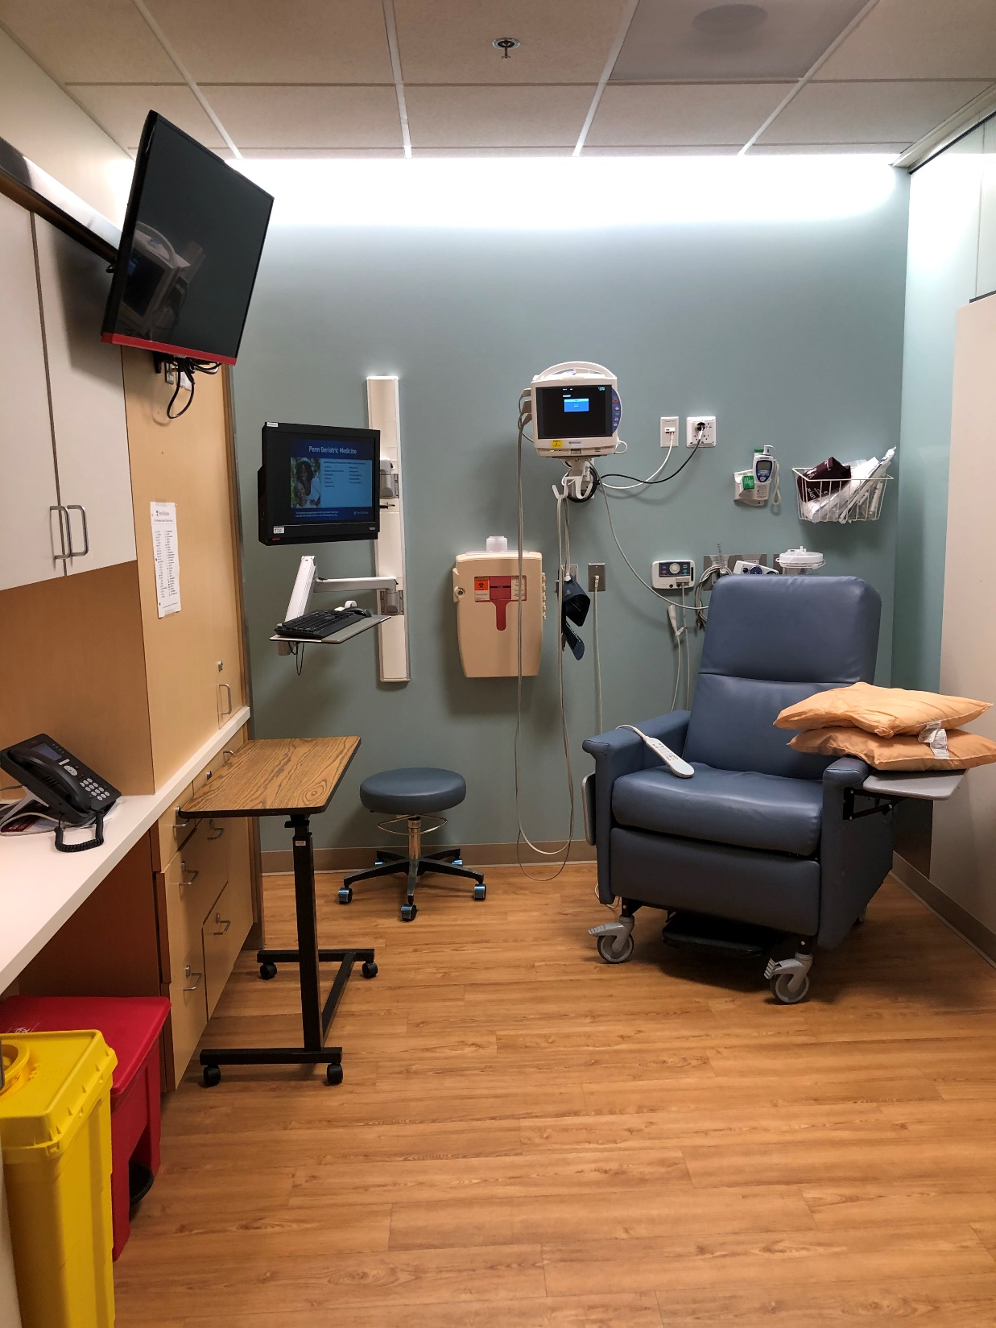
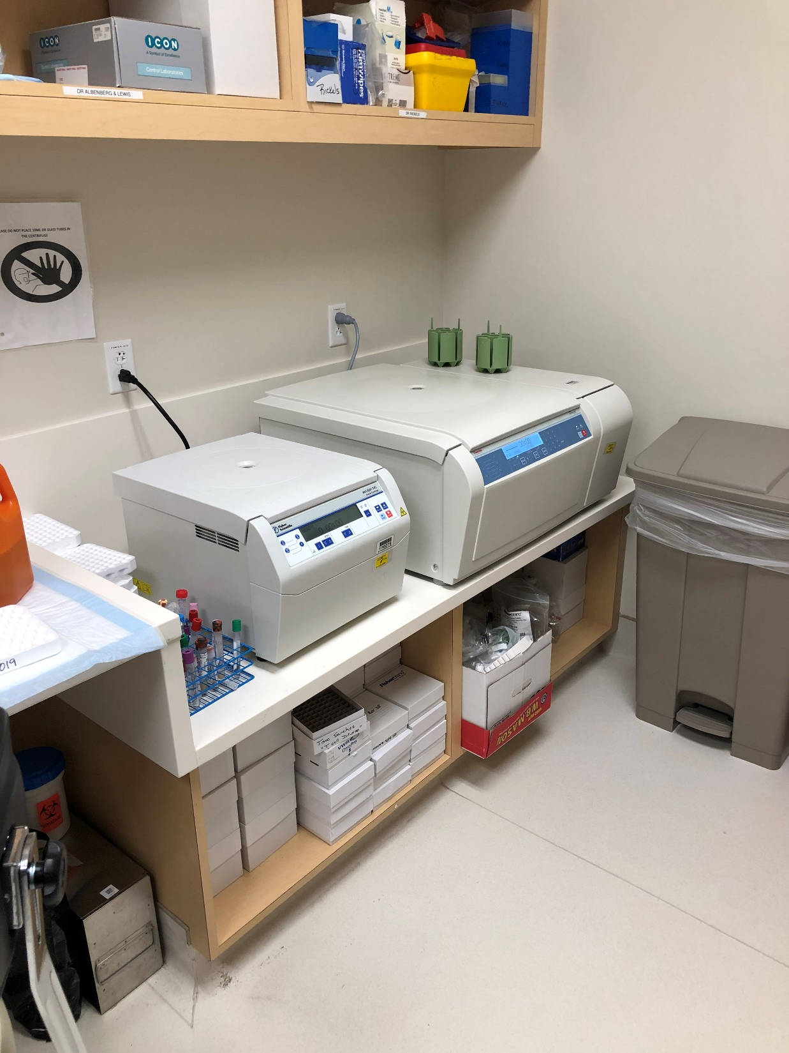

Slide 13
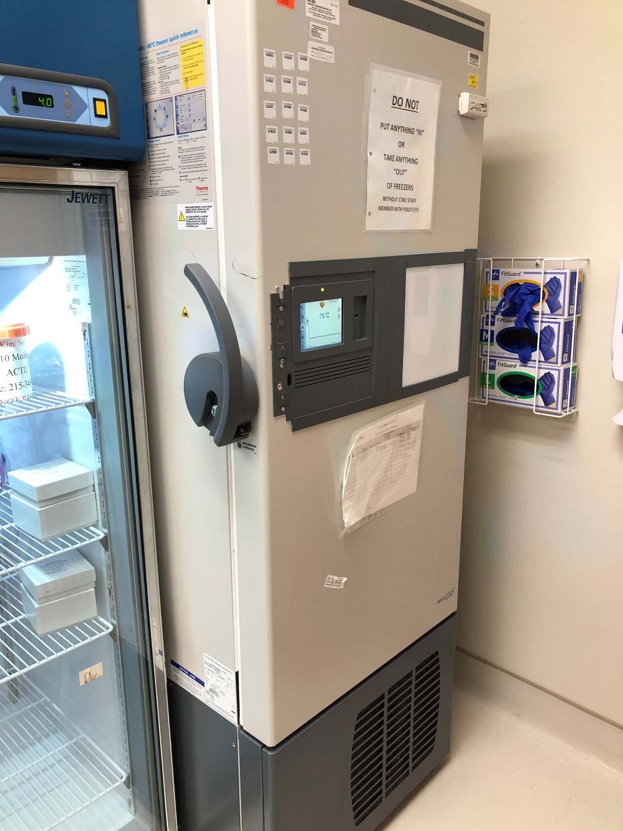
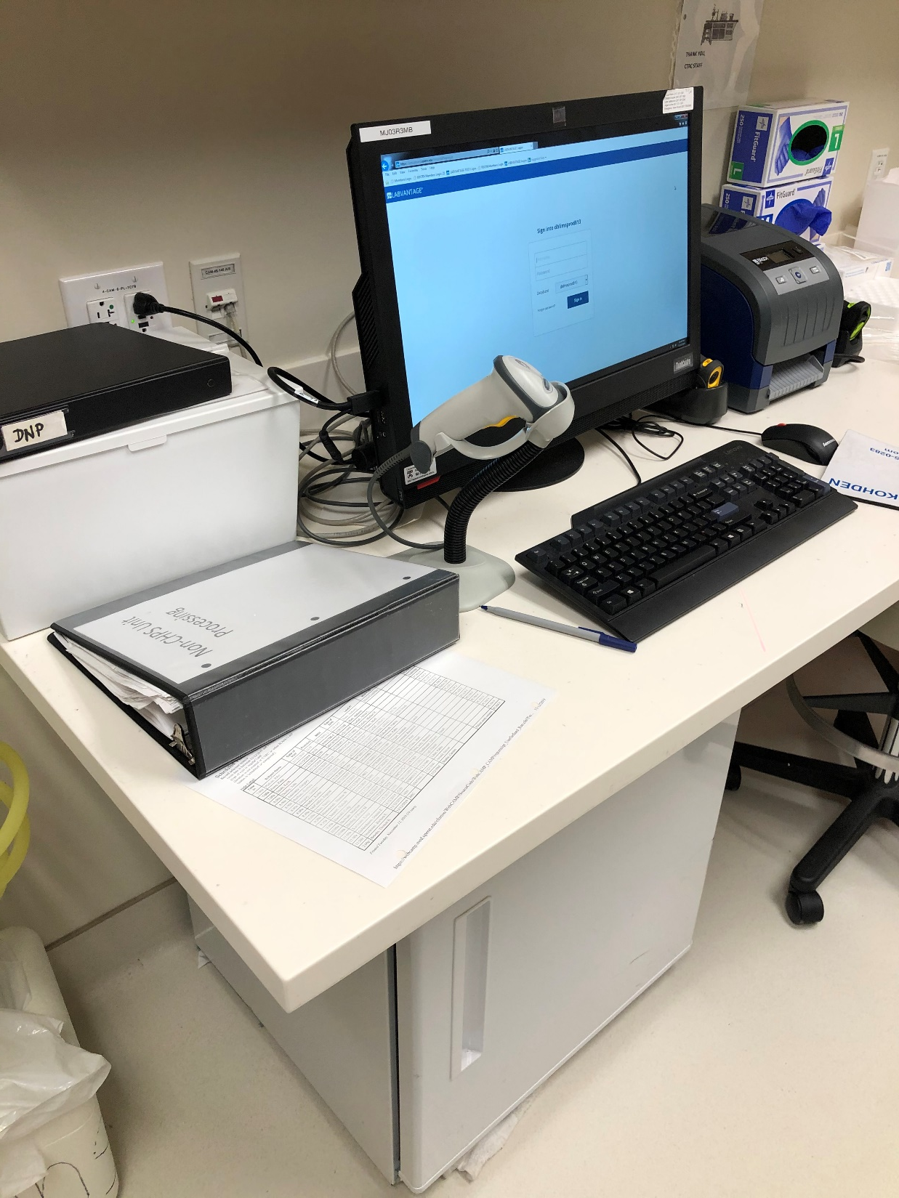

Slide 14
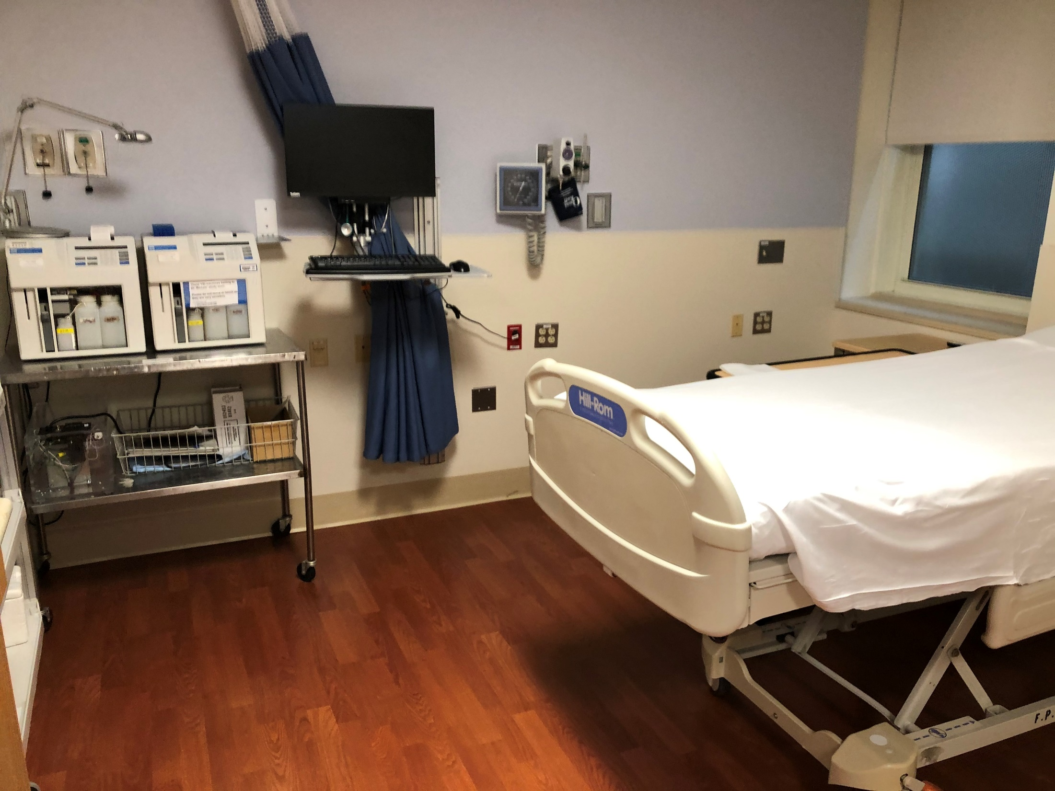

Slide 15
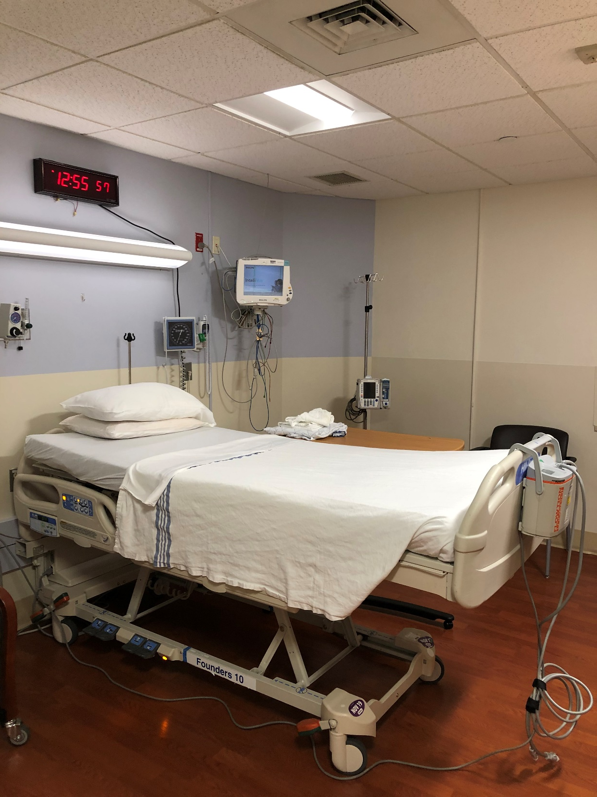
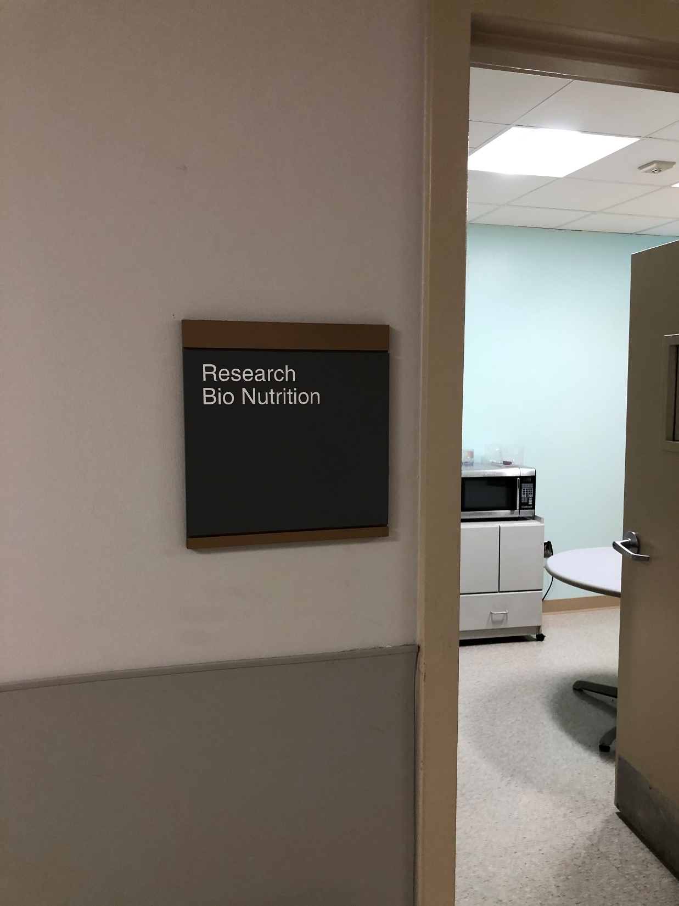

Slide 16
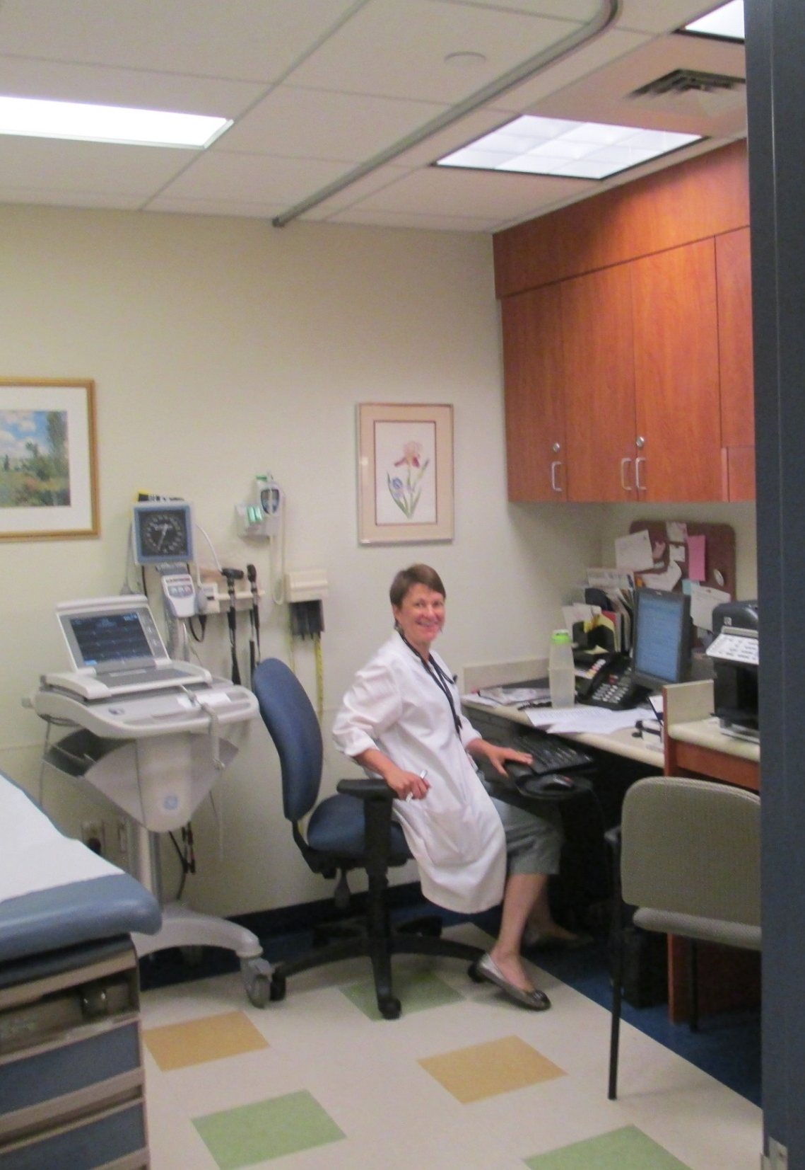
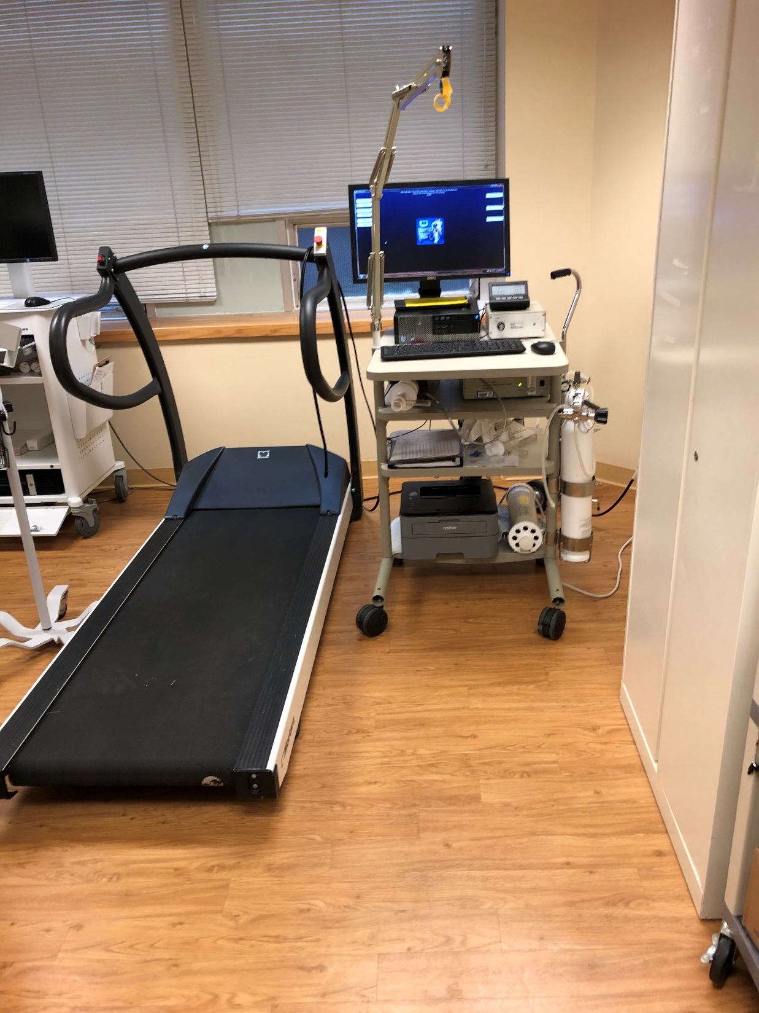

Slide 17
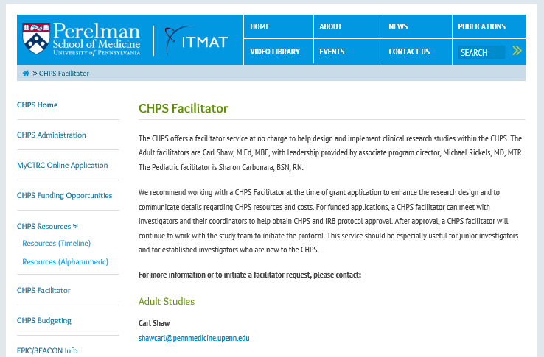


Slide 18

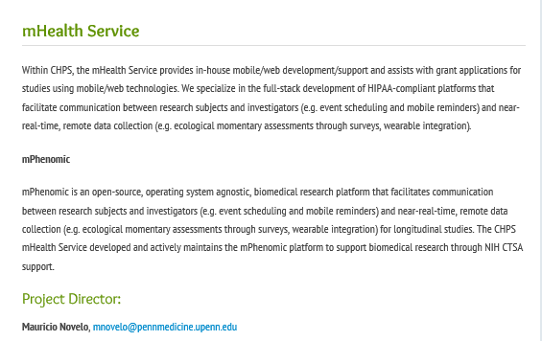
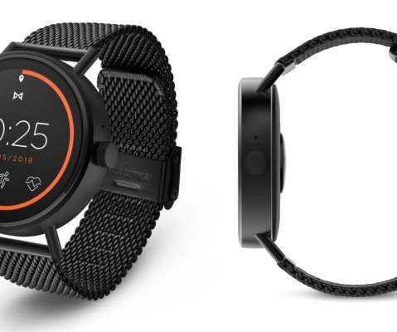

Slide 19
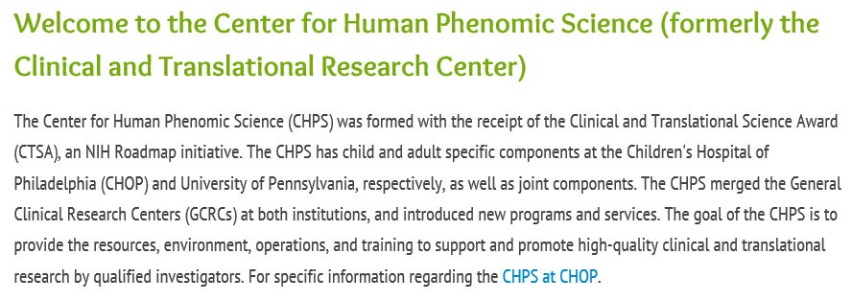
Structure
1 Dulles
PCAM 4 South
PPMC Mutch Building 1st Floor

Slide 20
Adult CHPS protocols by sponsor type

Slide 21
CTRC protocols by sponsor type
Focus Areas

Slide 22
Collaborations – Network - Resources
ITMAT Bioinformatics
Core
Clinical Research Computing Unit (CRCU)
Biostatistics Core
Biochemistry Core Lab
Center for Clinical Epidemiology and Biostatistics (CCEB)
Research Nurse Core
Kinetics Modeling and Simulation (KMAS)
Bionutritional Research Core
Clinical Translational Research Center
(CTRC)
Biomedical Lab
Post-Doctoral Fellow
Investigational Drug Service
Animal Facilities
Biostatistics,
Bioinformatics,
Pharmacometrics
ITMAT Clinical Trials Unit
Human Subject
Protection
Animal Testing
Research
Plan
Basic
Research
Physician-Scientist
Clinical
Research
Research
Plan
Institutional Animal Care and Use Committee (IACUC)
Biomedical Mass
Spectrometry
Industry
Regulatory
Science
Administration / Office of Human Research (OHR)
LC-MS/MS
Core
in
mice
Institutional
Review Board (IRB)
Development
of unbiased
markers
in
humans
CTRC Advisory Council
Office of Research Services (ORS)
Sample
Analysis
Food and Drug Administration (FDA)
External Scientific Adviser and Industry

Slide 23
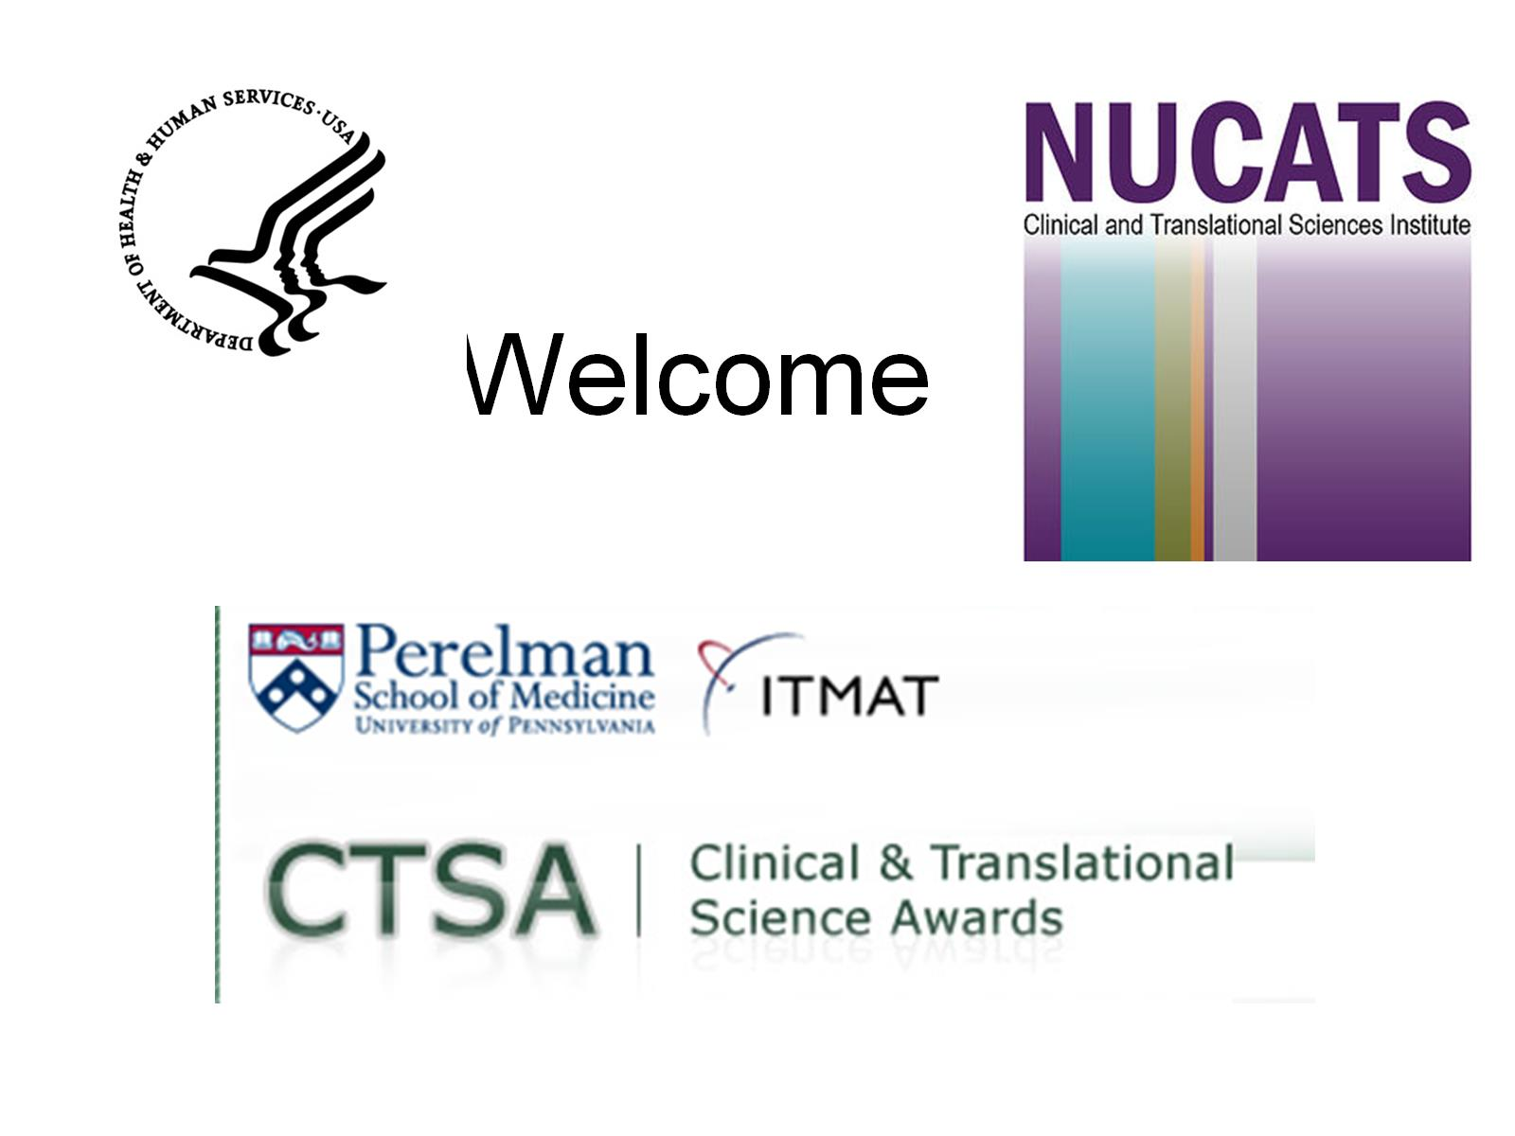

Welcome

Slide 24
Cost Schedule for Nursing for NIH supported Studies
  R: 50% CTSA/50% Grant
  K: 100% CTSA capped at $75k
  U: 50% CTSA/50% Grant
  P: 50% CTSA/50% Grant
  Small Grants (R21/R03): 80% CTSA/20% Grant

Slide 25
Why we do this -
No matter how well you alter (or correct) the pathophysiology in an animal disease model, you wont know whether it will help people until you study it in people
Without clinical and translational research our observations in the basic sciences, in observational cohort studies, and in our clinical practice(s) will simply consume our time, and serve no ultimate benefit

Slide 26

Recap
HOW LONG IS THIS
GOING TO TAKE?
WHAT IF MY
STUDY IS
NEGATIVE?
WE’VE GOT
THIS IDEA…
ETHICS
REGULATORY
TRAINING
IS IT WORTH IT?
FINDING
SUBJECTS
FUNDING
STORING THE
INFORMATION
PUBLISHING
STATISTICS
PRESENTING
LIFESTYLE
WHERE IS THE WORK GOING TO BE DONE?????

Slide 27

One more thing …

Slide 28
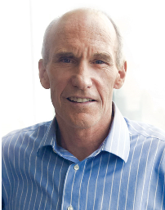
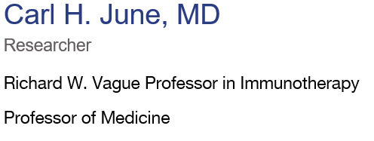
U.S. Naval Academy 1975
Trained as an Oncologist
In The Navy he also pursued Infectious Disease
That lead to research work with HIV
Early research with re-engineered HIV was undertaken
to modify the virus replication capability
Around 2002 the thought occurs that HIV might be useful
in the treatment of cancer cells
At that time most immunotherapy work was with
gammaretrovirus and mouse models
He found the HIV worked better to infect human T-cells
than the mouse virus vectors

Slide 29
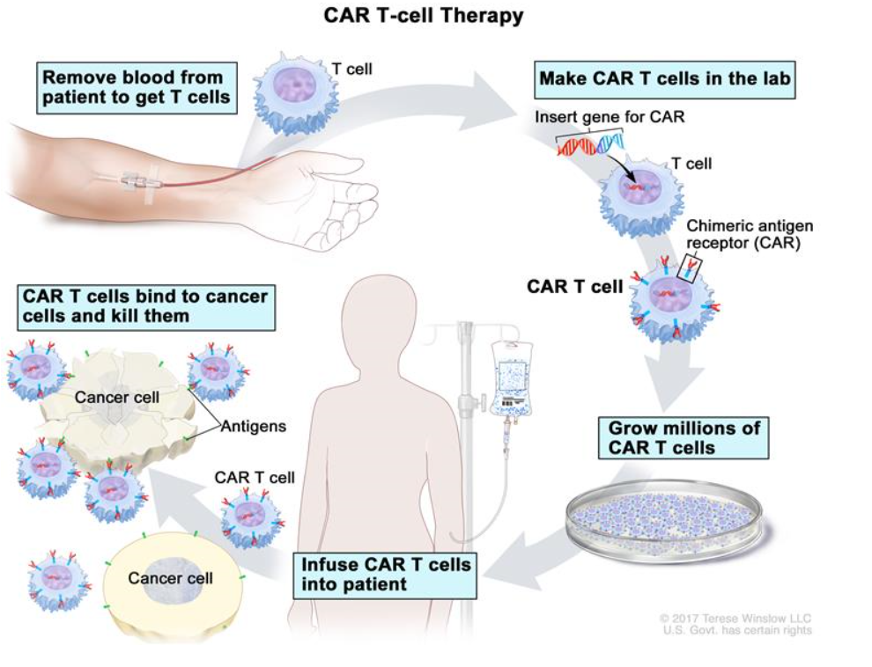

Slide 30
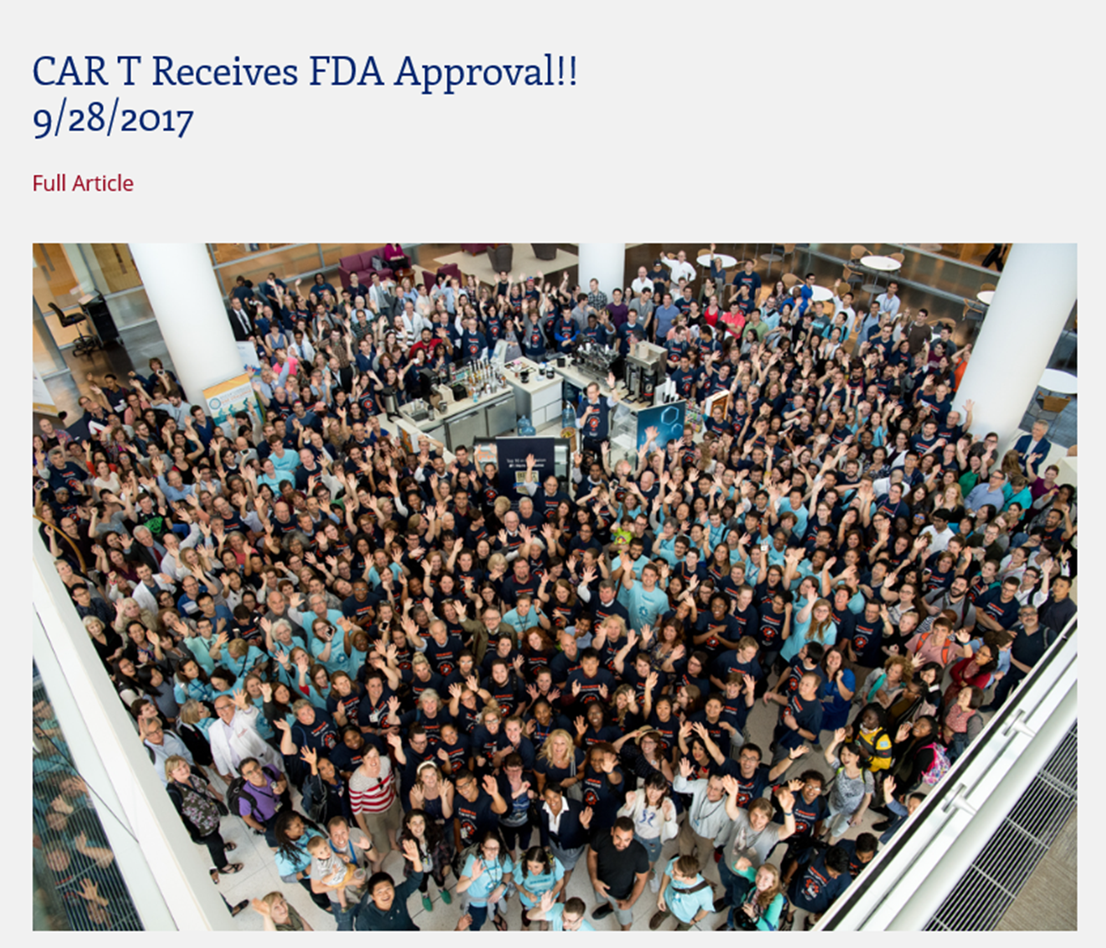

Slide 31
Where to find help
www.itmat.upenn.edu
http://www.itmat.upenn.edu/chps/
http://www.med.upenn.edu/clinrestraining/
townsend@upenn.edu

